Slide 1


Automated Integration and Validation System for E-Commerce and ERP Data
X
Romanos Rizk – 202471561
Hadil Fares - 202472597

Slide 2

INTRODUCTION
OBJECTIVES
DATA DESCRIPTION
ETL PROCESS
DATA RECONCILIATION
DASHBOARD

Slide 3
Introduction - Automated Integration and Validation System for E-Commerce and ERP Data
INTRODUCTION
OBJECTIVES
DATA DESCRIPTION
ETL PROCESS
DATA RECONCILIATION
DASHBOARD
The Malia Project aims to enhance data integrity and operational efficiency through automation and advanced data analysis within Malia Group's e-commerce operations.
Fast Evolving Technologies:
E-Commerce businesses now operate multiple data sources ranging from ERP to CRM systems, all utilizing the same transactional information
Why?
Rapid Industry Growth:
According to McKinsey insights, the global beauty and personal care market is projected to grow from $430 billion in 2022 to $580 billion by 2027
Future Proofing Operations:
With the technology and the industry expecting to grow, Malia would benefit from automated infrastructures that would allow it to continuously innovate

Slide 4

Malia Group: A Diversified Conglomerate
INTRODUCTION
OBJECTIVES
DATA DESCRIPTION
ETL PROCESS
DATA RECONCILIATION
DASHBOARD
25 Companies
6 Sectors
60 Brands
Product portfolio:
Haircare, skincare, body care for men, women, children State-of-the-art facilities:
Certified with ISO 9001 and Cosmetics GMP
3+ Countries
22+ Markets

Slide 5
Problem Statement
INTRODUCTION
OBJECTIVES
DATA DESCRIPTION
ETL PROCESS
DATA RECONCILIATION
DASHBOARD
Presently, while orders placed on Malia’s website are recorded within the ERP, collections received from shipping companies require manual entry into the system and subsequent matching with corresponding invoices.
This manual intensive process deteriorates Malia’s data integrity and leads to mismatches between similar transactions present in different data sources

Slide 6
Objectives
INTRODUCTION
OBJECTIVES
DATA DESCRIPTION
ETL PROCESS
DATA RECONCILIATION
DASHBOARD
Automated Data Entry
Automated Extract, Transform, Load (ETL) system that will extract the data from all the present sources, convert them into appropriate format, and store them into a permanent database for monitoring and analysis
Automated Reconciliation
Automated validation and reconciliation processes to improve the reliability of financial data and detect discrepancies between different data sources.
Real-Time Monitoring
Advanced dashboards for real-time insights into e-commerce transactions and transaction level tracking capabilities
Boost Cosmaline Sales
Utilize forecasting and data mining techniques to help Malia Group boos sales by creating successful cross-selling, bundling, and marketing initiatives.
6

Slide 7
Data Overview
INTRODUCTION
OBJECTIVES
DATA DESCRIPTION
ETL PROCESS
DATA RECONCILIATION
DASHBOARD
Website ECOM Data
Shipped & Collected - Aramex
Shipped & Collected - Cosmaline
Collected - Credit Card
Rows: 10,389
Columns: 9
Features:
Order numbers
Shipper names
Creation date
delivery date
Billing types
Cart amounts
Currencies
Airway bills (AWB)
Rows: 8,810
Columns: 8
Features:
Shippers numbers
HAWB (House Air Waybill)
Delivery dates
COD amounts
Invoice dates
Rows: 1,370
Columns: 8
Features:
Shipper numbers,
HAWB
Delivery dates,
COD amounts
Invoice dates.
Rows: 210
Columns: 4
Features:
Order number
Payment amounts
Payment dates

Slide 8
Data Overview
INTRODUCTION
OBJECTIVES
DATA DESCRIPTION
ETL PROCESS
DATA RECONCILIATION
DASHBOARD
ERP-Oracle Collection
Oracle Data
Daily Rate
Oracle Product Names
Rows: 123
Columns: 9
Features:
Receipt numbers
Receipt class
Receipt amount
Receipt date
Currency code
Comment
Rows: 2,555
Columns: 13
Features:
Oracle reference number
E-commerce reference number
Ordered item
Ordered quantity
Ordered date
Rows: 117
Columns: 2
Features:
Rate
Date
Rows: 639
Columns: 3
Features:
Product names
Product categories
Product ids

Slide 9

Extraction: Excel
INTRODUCTION
OBJECTIVES
DATA DESCRIPTION
ETL PROCESS
DATA RECONCILIATION
DASHBOARD
Website ECOM Data
ERP-Oracle Collection
Shipped & Collected - Aramex
Shipped & Collected - Cosmaline
Collected - Credit Card
Oracle Data
Daily Rate

Slide 10
Transformation Measures
INTRODUCTION
OBJECTIVES
DATA DESCRIPTION
ETL PROCESS
DATA RECONCILIATION
DASHBOARD
1
Ensuring that all data fields are standardized to match the database schema for accurate storage and analysis.
Data Type Conversion
2
Text Normalization
Converting columns to lowercase or uppercase and trimming white spaces to maintain consistency across all datasets.
3
Handing Missing Values
Removing incomplete or duplicated records to improve data quality and ensure that all analysis is based on clean, accurate data.
4
Column Renaming
Renaming columns to ensure consistency with the database schema, facilitating smoother integration and analysis.
5
Data Joining
Merging data from different sources to streamline information into a cohesive format, ready for further analysis.

Slide 11
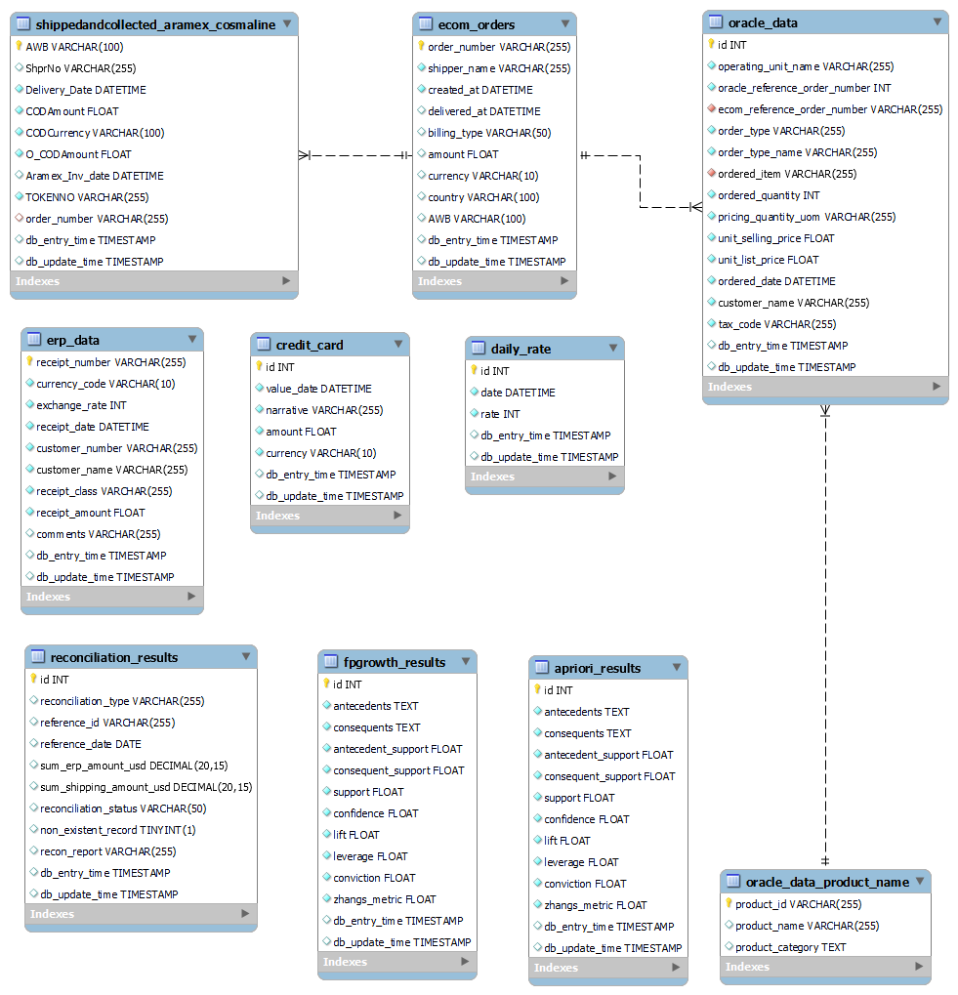
Database Schema
INTRODUCTION
OBJECTIVES
DATA DESCRIPTION
ETL PROCESS
DATA RECONCILIATION
DASHBOARD
Load:

Slide 12

Reconciliation KPIs
INTRODUCTION
OBJECTIVES
DATA DESCRIPTION
ETL PROCESS
DATA RECONCILIATION
DASHBOARD
01
Consistency between ECOM Cash and ERP Cash Transactions
02
Consistency between ECOM Cash and Aramex Shipping Cash Transactions
03
Consistency between ECOM Cash and Cosmaline Shipping Cash Transactions
04
Consistency between ECOM Cybersource and Credit Card Transactions
05
Ensure that all orders are accounted for across various data sources.

Slide 13
Order Presence Reconciliation
INTRODUCTION
OBJECTIVES
DATA DESCRIPTION
ETL PROCESS
DATA RECONCILIATION
DASHBOARD
01
02
03
04
Verifies that all e-commerce orders exist in the shipping records.
Ensures that all e-commerce orders are reflected in the Oracle ERP data.
Ensures all shipping data corresponds with recorded e-commerce orders.
Validates that all Oracle order numbers have corresponding e-commerce orders.
ecom_orders_not_in_
shipping_reconciliation.sql
ecom_orders_not_in_
oracle_reconciliation.sql
invalid_shipping_order_
numbers_reconciliation.sql
invalid_oracle_order_
numbers_reconciliation.sql

Slide 14
Financial Data Reconciliation
INTRODUCTION
OBJECTIVES
DATA DESCRIPTION
ETL PROCESS
DATA RECONCILIATION
DASHBOARD
ecom_reconciliation.sql:
Compares recorded amounts in e-commerce orders with ERP amounts, adjusting for currency differences.
credit_card_reconciliation.sql:
Verifies consistency between ERP and credit card transaction data (Cybersource) using a 5% threshold for matching.
cosmaline_reconciliation.sql:
Ensures consistency between Cosmaline shipments in ERP and Cosmaline shipping records with a 5% threshold.
token_reconciliation.sql:
Compares token transactions from ERP data with Aramex shipping records, converts amounts to USD, and applies a 5% matching threshold.

Slide 15

WHY Monitoring?
INTRODUCTION
OBJECTIVES
DATA DESCRIPTION
ETL PROCESS
DATA RECONCILIATION
DASHBOARD

Slide 16
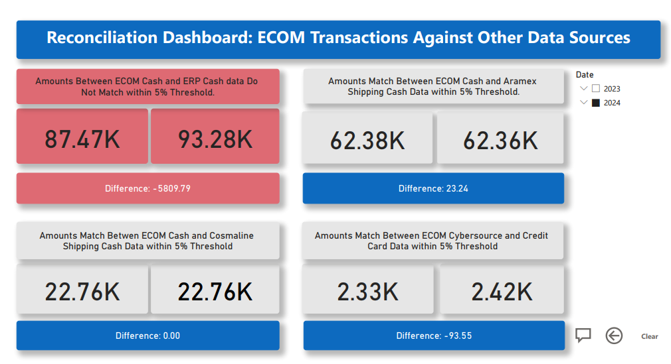
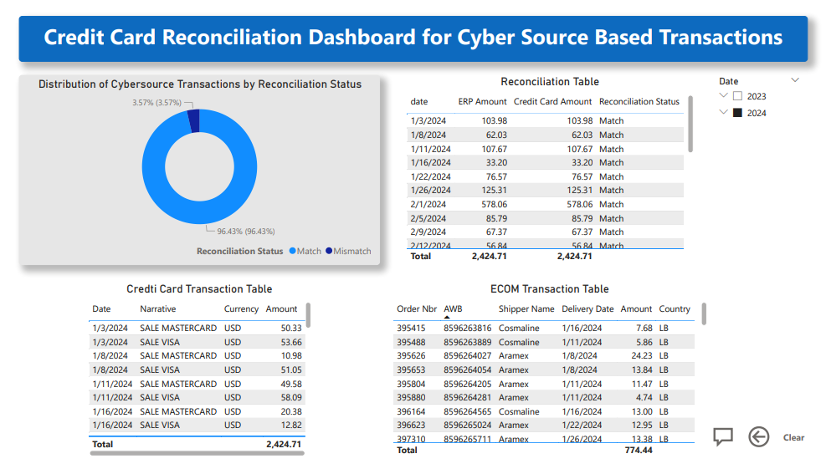
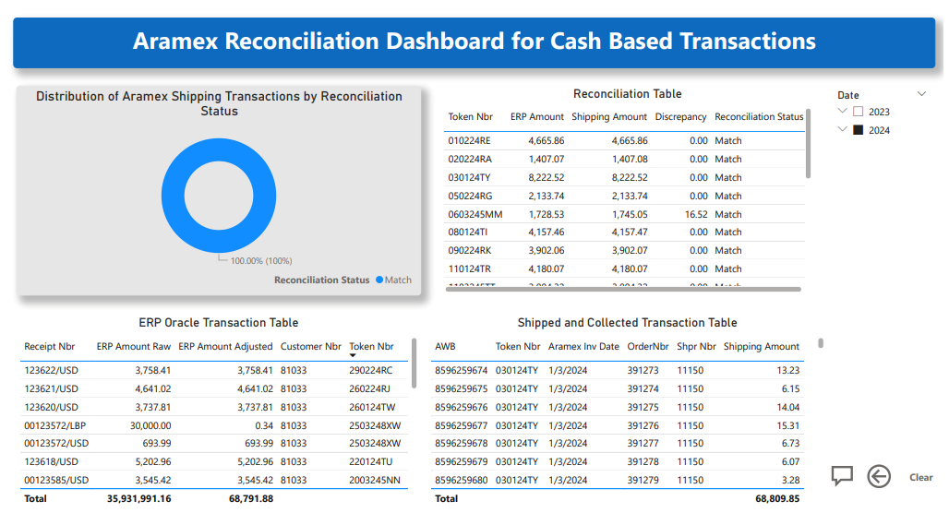
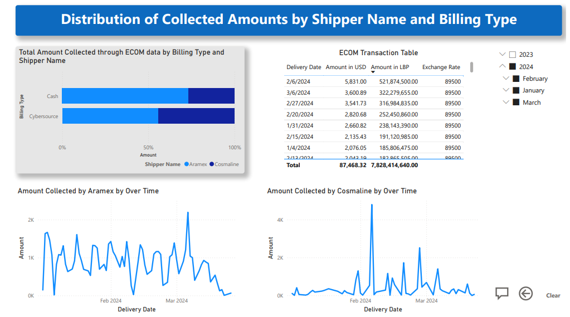
INTRODUCTION
OBJECTIVES
DATA DESCRIPTION
ETL PROCESS
DATA RECONCILIATION
DASHBOARD

Slide 17
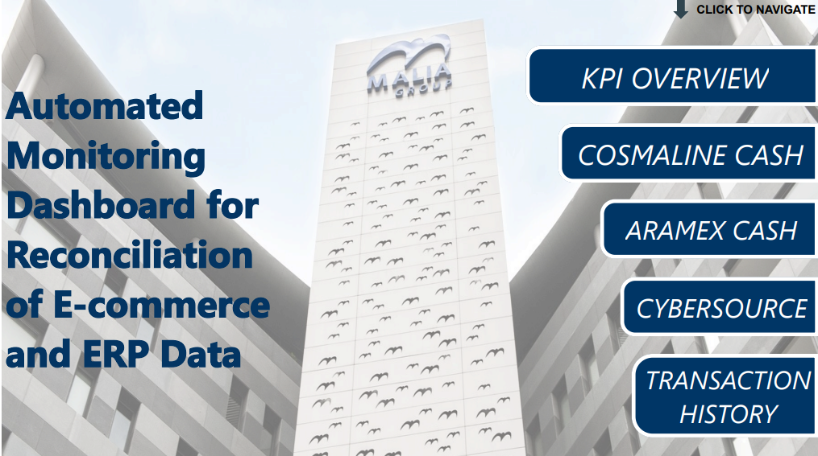
INTRODUCTION
OBJECTIVES
DATA DESCRIPTION
ETL PROCESS
DATA RECONCILIATION
DASHBOARD

Slide 18
Dashboard Results
INTRODUCTION
OBJECTIVES
DATA DESCRIPTION
ETL PROCESS
DATA RECONCILIATION
DASHBOARD
ECOM Cash VS ERP Cash
ECOM Cash vs. Aramex Cash
ECOM Cash vs. Cosmaline Cash
$6,544.85 in 2023
$0.00 in 2023
$0.00 in 2023
-$5,809.70 in 2024
$23.24 in 2024
$0.00 in 2024
-$1300.18 in January
-$5,243.21 in February
-$733.60 in March
$0.00 in January
$0.00 in February
$23.24 in March
$0.00 in January
$0.00 in February
$23.24 in March
Cybersource VS Credit Card
Aramex VS ERP
Cosmaline VS ERP
-$93.55 in 2023
0.00% in 2023
0.00% in 2023
-$93.55 in 2024
0.00% in 2024
9.99% in 2024
-$484.50 in January
$484.50 in February
$0.01 in March
0.00% in January
0.00% in February
0.00% in March
0.00% in January
0.00% in February
66.67% in March

Slide 19

FORECASTING ANALYSIS
BUSINESS ANALYTICS
AIRFLOW AUTOMATED SYSTEM
RECOMMENDATIONS

Slide 20
FORECASTING ANALYSIS
BUSINESS ANALYTICS
AIRFLOW AUTOMATED SYSTEM
RECOMMENDATIONS
Different forecasting models were used to analyze the transaction data from the 'ecom_orders' table. However, it is important to consider the limitations:
Forecasting Analysis
of E-commerce Sales:
The Limitations
A total of 124 missing days between June 2023 and October 2024, Resulting in only 4 month were accounted in the Forecasting
This forecasting analysis is intended as a model to what could be used by the company when more data is available. It is this important to not that the following section could have been more relevant if more data was available to use.

Slide 21
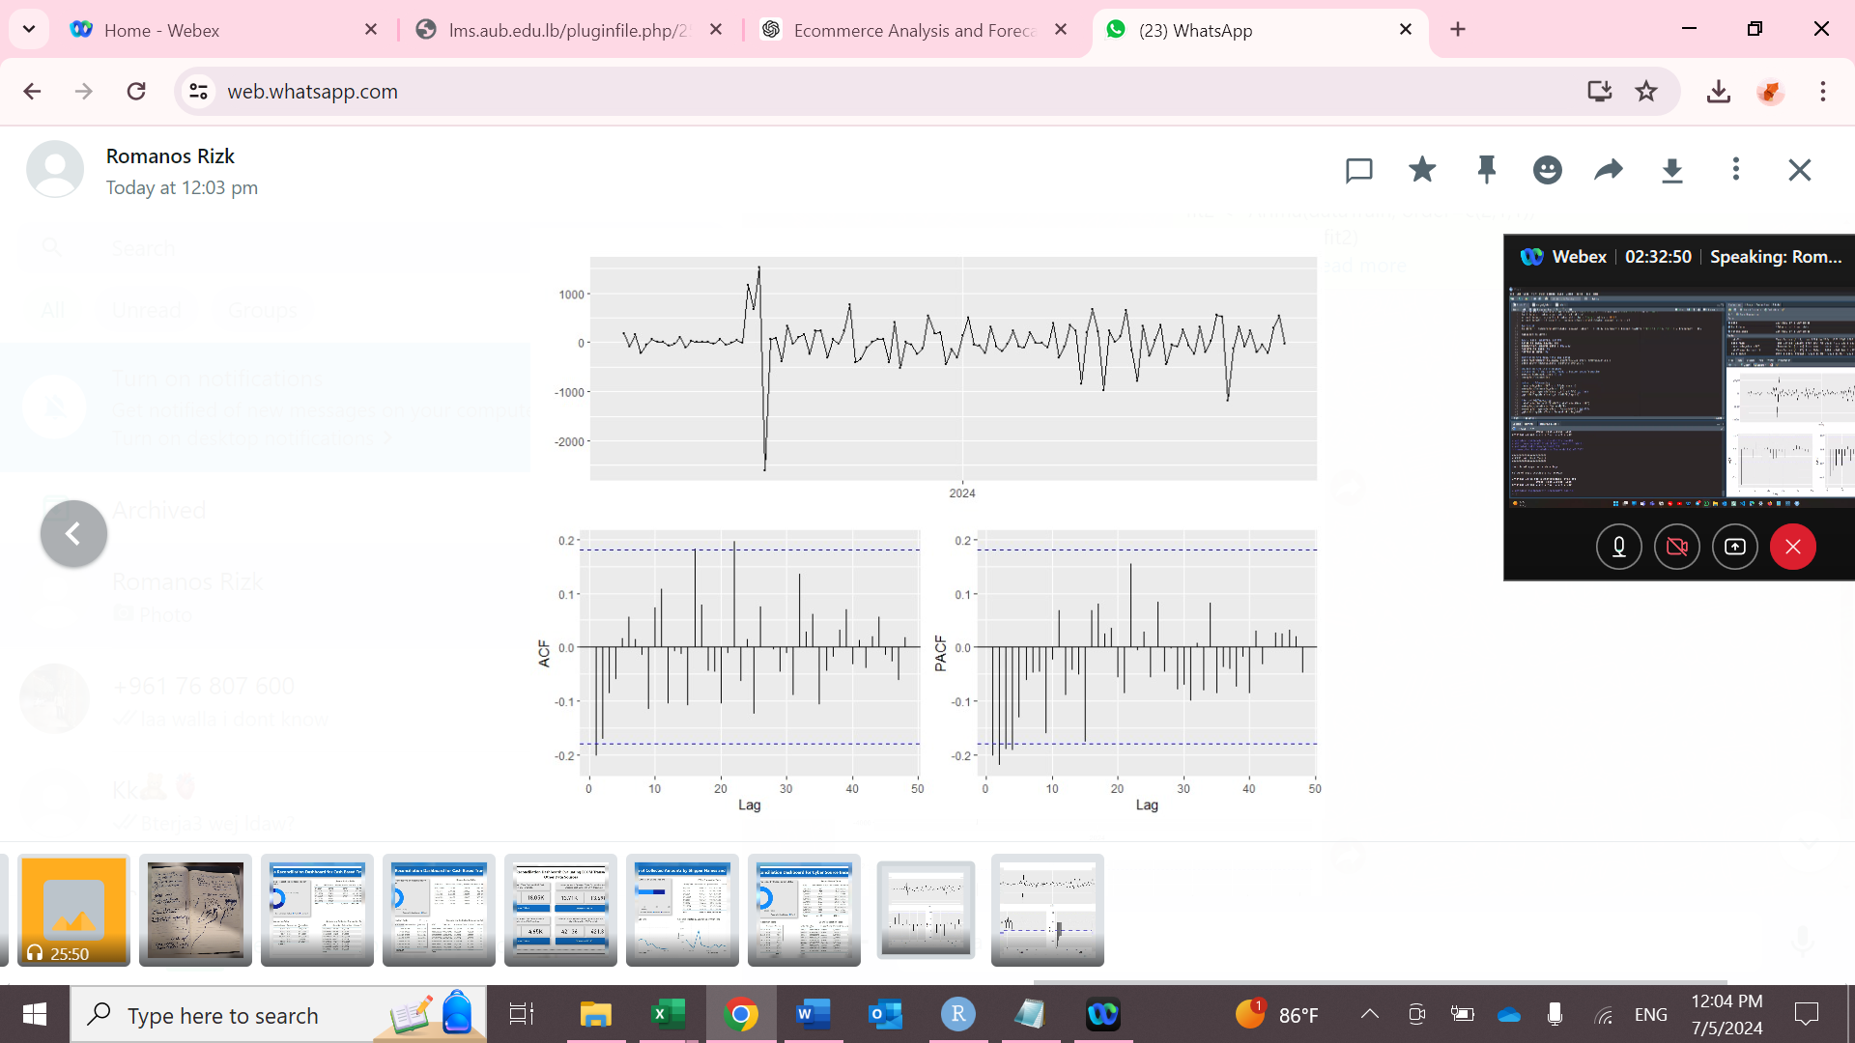
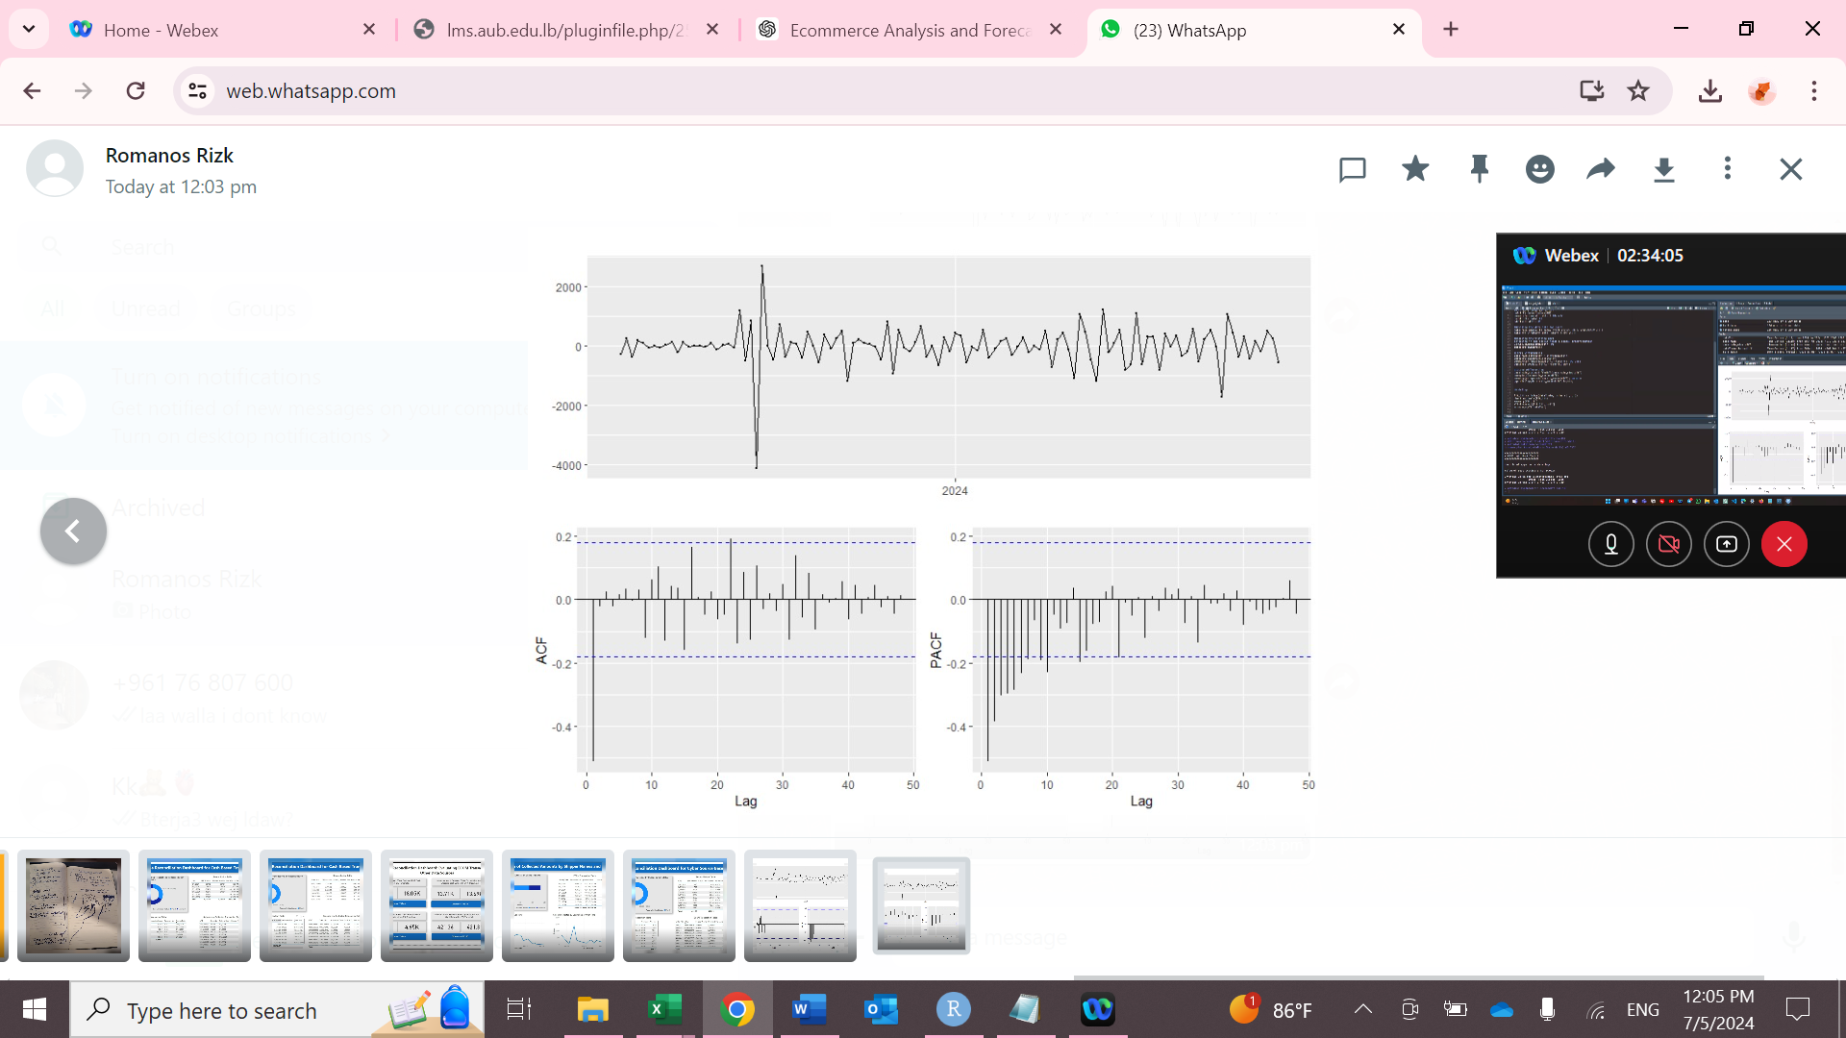
Plots, Autocorrelation Function, and Partial Autocorrelation Function
FORECASTING ANALYSIS
BUSINESS ANALYTICS
AIRFLOW AUTOMATED SYSTEM
RECOMMENDATIONS
After 1st differencing
After 2nd differencing

Slide 22
Models Tried & Performances
FORECASTING ANALYSIS
BUSINESS ANALYTICS
AIRFLOW AUTOMATED SYSTEM
RECOMMENDATIONS
Autoregressive Integrated Moving Average: ARIMA Model
Model | MAPE | RMSE | AICc | Ljung_Box_pvalue | Residuals
ARIMA(1,1,1) | 24.47302 | 339.1476 | 1750.36 | 0.6523 | No Autocorrelation
ARIMA(2,1,1) | 24.85088 | 354.1572 | 1751.49 | 0.769 | No Autocorrelation
ARIMA(0,2,1) | 58.83586 | 561.1928 | 1761.35 | 0.1155 | No Autocorrelation
Error Trend Seasonality: ETS Model
Model | MAPE | RMSE | AICc | Ljung_Box_pvalue | Residuals
ETS(A, A, N) | 46.10862 | 465.636 | 2011.24 | 0.0862 | No Autocorrelation
ETS(M, A, N) | 104.6655 | 1024.613 | 2178.92 | 0.0528 | No Autocorrelation
ETS(M, M, N) | 199.3808 | 1929.638 | 2133.74 | 0.1305 | No Autocorrelation
ETS(A, N, N) | 38.74234 | 409.5922 | 2007.11 | 0.0886 | No Autocorrelation
Averaging Best Performing Models
 | ME | RMSE | MAE | MPE | MAPE | ACF1 | Theil's U
Test set | -96.4758 | 365.9072 | 282.9767 | -20.5533 | 30.77836 | 0.537514 | 1.919144

Slide 23
Models Tried & Performances
FORECASTING ANALYSIS
BUSINESS ANALYTICS
AIRFLOW AUTOMATED SYSTEM
RECOMMENDATIONS
Autoregressive Integrated Moving Average: ARIMA Model
Model | MAPE | RMSE | AICc | Ljung_Box_pvalue | Residuals
ARIMA(1,1,1) | 24.47302 | 339.1476 | 1750.36 | 0.6523 | No Autocorrelation
ARIMA(2,1,1) | 24.85088 | 354.1572 | 1751.49 | 0.769 | No Autocorrelation
ARIMA(0,2,1) | 58.83586 | 561.1928 | 1761.35 | 0.1155 | No Autocorrelation
Error Trend Seasonality: ETS Model
Model | MAPE | RMSE | AICc | Ljung_Box_pvalue | Residuals
ETS(A, A, N) | 46.10862 | 465.636 | 2011.24 | 0.0862 | No Autocorrelation
ETS(M, A, N) | 104.6655 | 1024.613 | 2178.92 | 0.0528 | No Autocorrelation
ETS(M, M, N) | 199.3808 | 1929.638 | 2133.74 | 0.1305 | No Autocorrelation
ETS(A, N, N) | 38.74234 | 409.5922 | 2007.11 | 0.0886 | No Autocorrelation
Averaging Best Performing Models
 | ME | RMSE | MAE | MPE | MAPE | ACF1 | Theil's U
Test set | -96.4758 | 365.9072 | 282.9767 | -20.5533 | 30.77836 | 0.537514 | 1.919144

Slide 24
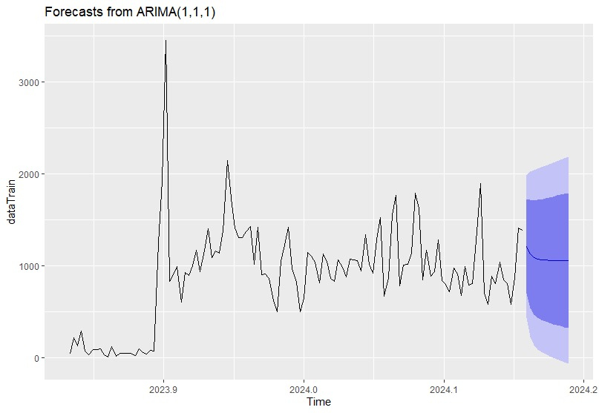
Forecasting Result
FORECASTING ANALYSIS
BUSINESS ANALYTICS
AIRFLOW AUTOMATED SYSTEM
RECOMMENDATIONS

Slide 25
FORECASTING ANALYSIS
BUSINESS ANALYTICS
AIRFLOW AUTOMATED SYSTEM
RECOMMENDATIONS
Future sales
on Average
Approx.
$1000
HOW?
Transaction Based Analysis

Slide 26

Data Mining: Market Basket Analysis
FORECASTING ANALYSIS
BUSINESS ANALYTICS
AIRFLOW AUTOMATED SYSTEM
RECOMMENDATIONS
What is it?
A data mining technique that identifies patterns and associations between items frequently purchased together.
Purpose
Uncover insights into customer buying behavior.
Business Impact
Helps develop effective cross-selling strategies.
Optimizes product placement.
Increases sales and enhances customer satisfaction

Slide 27






Transactional Data
FORECASTING ANALYSIS
BUSINESS ANALYTICS
AIRFLOW AUTOMATED SYSTEM
RECOMMENDATIONS
Market Basket Analysis: Requirements
Oracle dataset
MBA
requires
Product ID
Order nb.
Product names
dataset
Scraped data

Slide 28
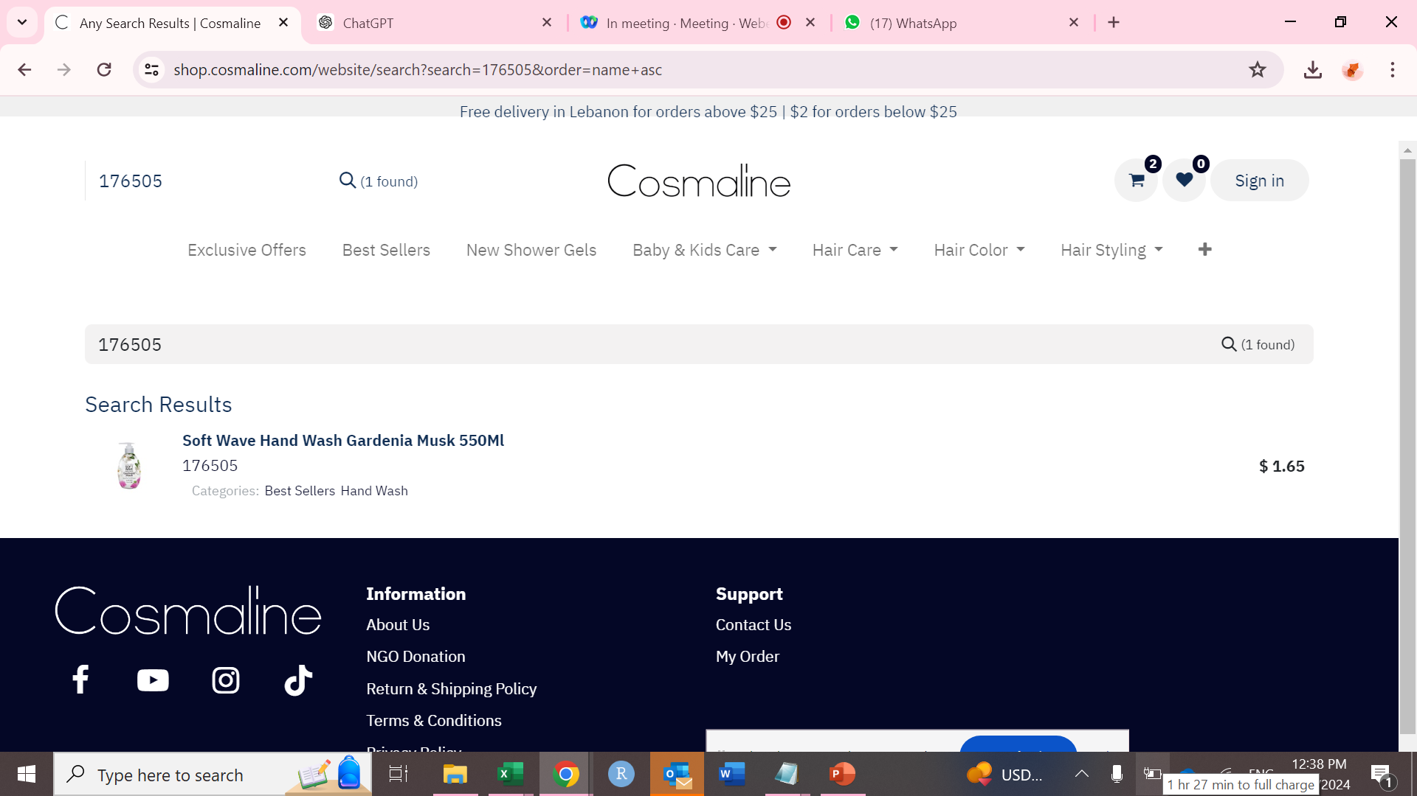
FORECASTING ANALYSIS
BUSINESS ANALYTICS
AIRFLOW AUTOMATED SYSTEM
RECOMMENDATIONS
Scraping Logic
Step 1
Search for Product ID
Step 2
Extract product name
Step 3
Extract product category

Slide 29
FORECASTING ANALYSIS
BUSINESS ANALYTICS
AIRFLOW AUTOMATED SYSTEM
RECOMMENDATIONS
Exploratory Data Analysis (EDA)
01
02
03
04
Analyzed top-selling products, monthly sales trends, revenue contribution by category, and order quantity distribution.
Examined customer purchasing behaviors, including recency, order quantities, and basket sizes.
Investigated pricing strategies, discount distributions, and their impact on sales performance.
Assessed product diversity in transactions and identified niche products based on low sales and frequency
Sales
Analysis
Order
Analysis
Pricing & Discount Analysis
Product Positioning
Analysis

Slide 30
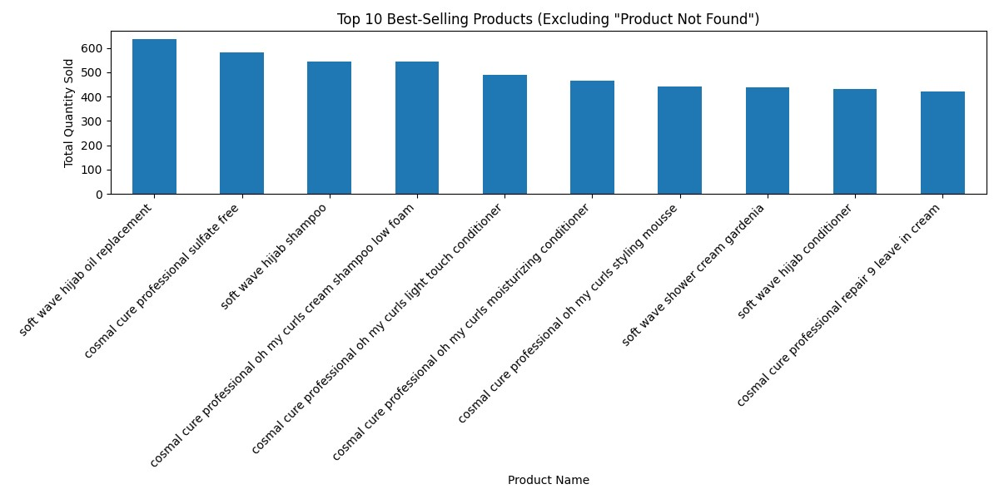
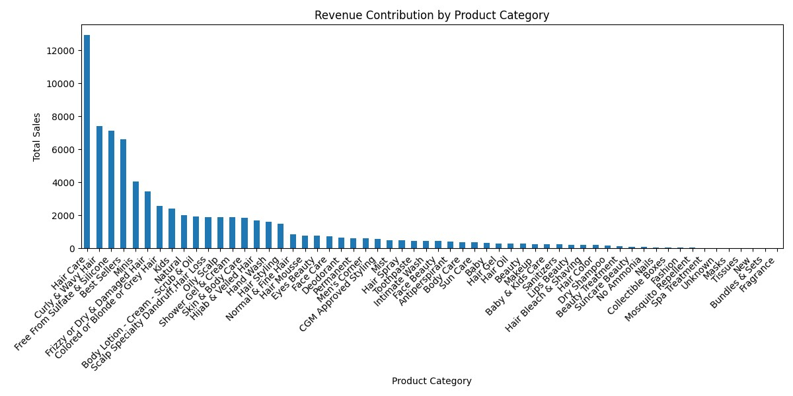
Exploratory Data Analysis: Sales Analysis
FORECASTING ANALYSIS
BUSINESS ANALYTICS
AIRFLOW AUTOMATED SYSTEM
RECOMMENDATIONS

Slide 31
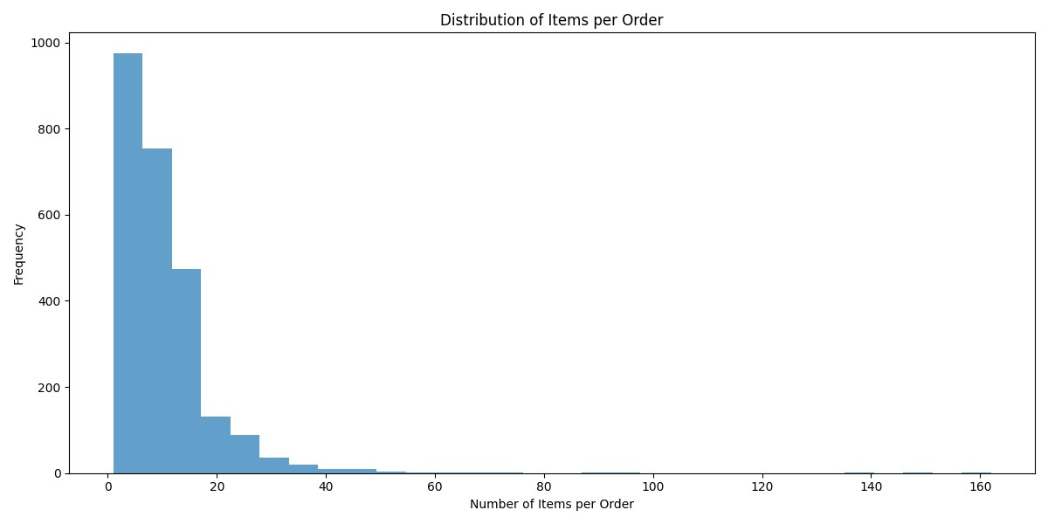
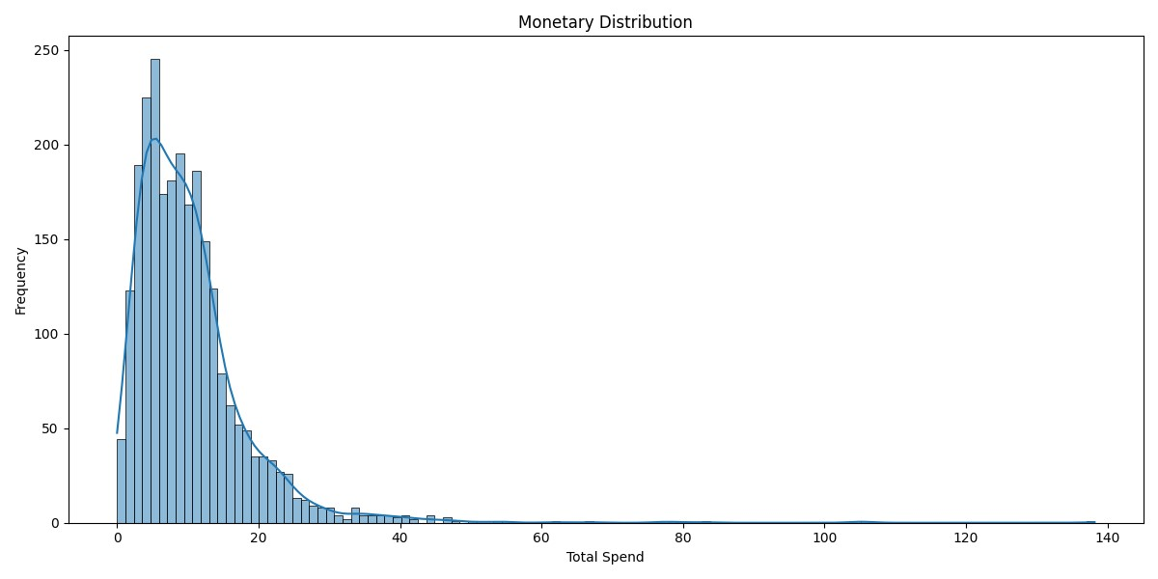
Exploratory Data Analysis: Order Analysis
FORECASTING ANALYSIS
BUSINESS ANALYTICS
AIRFLOW AUTOMATED SYSTEM
RECOMMENDATIONS

Slide 32
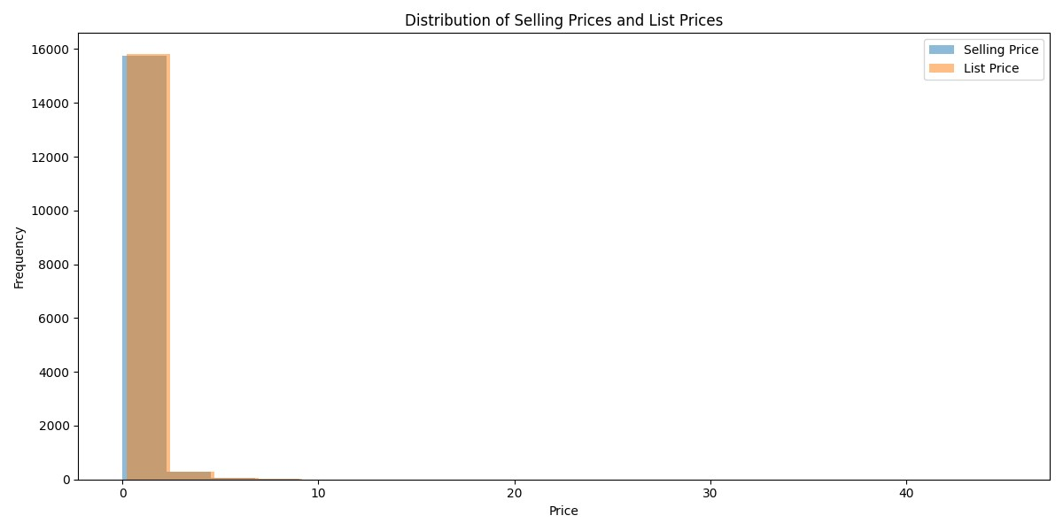
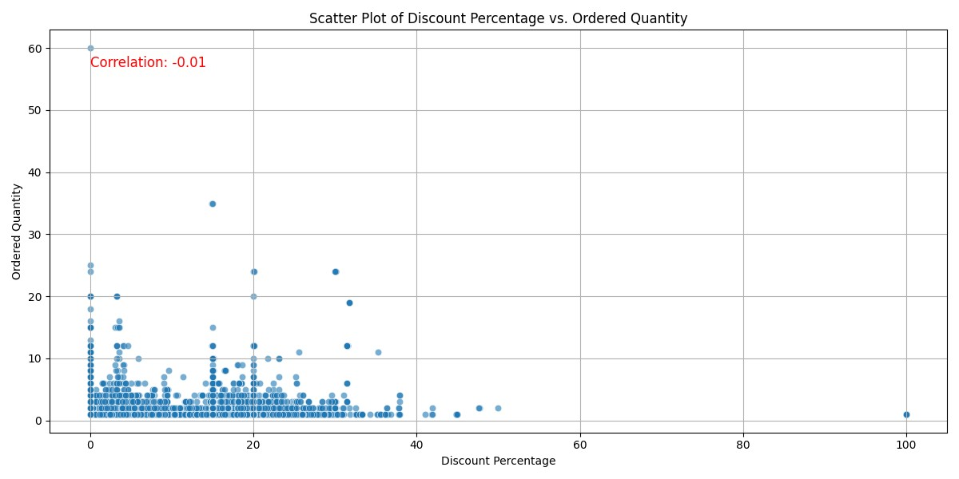
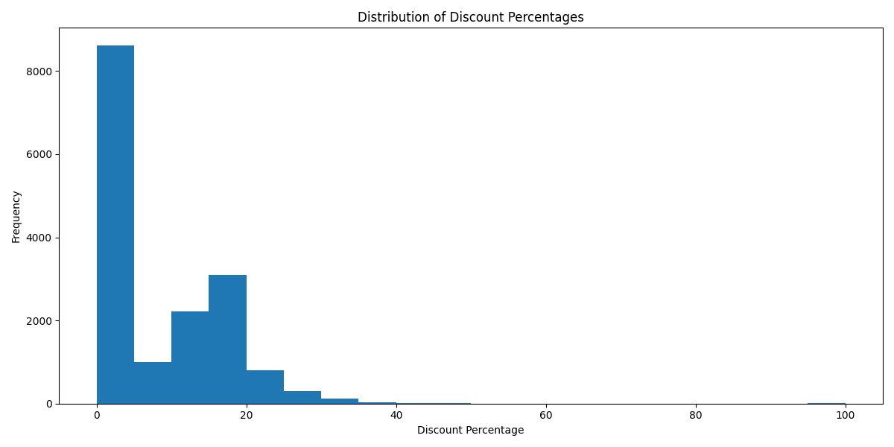
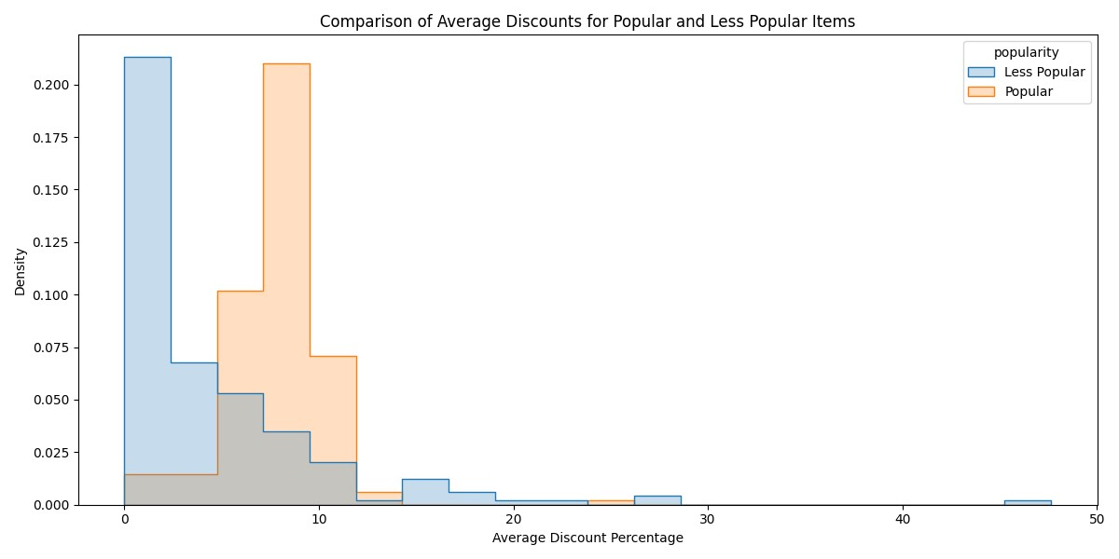
FORECASTING ANALYSIS
BUSINESS ANALYTICS
AIRFLOW AUTOMATED SYSTEM
RECOMMENDATIONS
EDA: Pricing and Discount Analysis

Slide 33
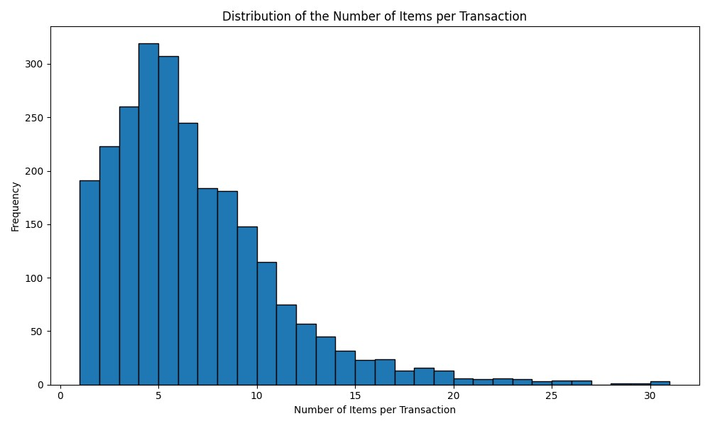
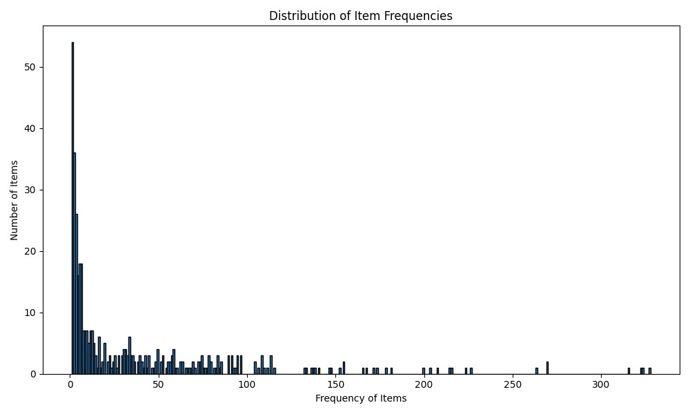
FORECASTING ANALYSIS
BUSINESS ANALYTICS
AIRFLOW AUTOMATED SYSTEM
RECOMMENDATIONS
Exploratory Data Analysis: Product Positioning
Analysis

Slide 34
FORECASTING ANALYSIS
BUSINESS ANALYTICS
AIRFLOW AUTOMATED SYSTEM
RECOMMENDATIONS
Product Name
koleston kit light ash blonde 8
essence pumpkins pretty matte nail polish
koleston maxi single light brown 305 0
essence super fine liner pen
essence disney mickey friends bouncy
invigo leave in wonder balm
fine napkin 40 1ply black
collistar reshaping draining wraps
eimi sugar lift
cosmaline baby discovery kit
soft color kit 71 ash
essence pumpkins pretty creamy shadow liner
collistar reshaping draining solution refill
essence after shape brow roller cooling and
essence pumpkins pretty eyeshadow palette
Exploratory Data Analysis: Product Positioning
Sample of Niche Products: Based on Frequency and Sales Volume

Slide 35
Market Basket Analysis: Algorithms
FORECASTING ANALYSIS
BUSINESS ANALYTICS
AIRFLOW AUTOMATED SYSTEM
RECOMMENDATIONS
Used for frequent itemset mining and association rule learning in transactional datasets.
Purpose
Apriori Algorithm
FP-Growth Algorithm
Identify frequent single items, then generate pairs, triplets, etc.
Remove itemsets that don't meet the minimum support.
Continue until no larger frequent itemsets are found.
Create association rules from the frequent itemsets that meet the confidence and lift thresholds.
Organize frequent items into a compressed tree structure.
Traverse the tree to find frequent itemsets.
For each item, generate conditional trees and mine further frequent itemsets.
Create association rules from the frequent itemsets.
How It Works
35

Slide 36
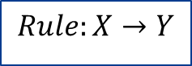

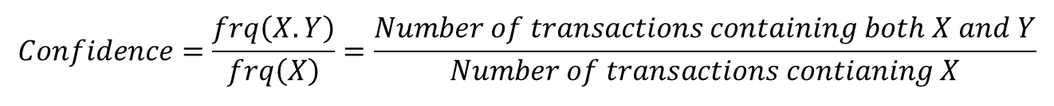
FORECASTING ANALYSIS
BUSINESS ANALYTICS
AIRFLOW AUTOMATED SYSTEM
RECOMMENDATIONS
$$Rule:X→Y$$
$$Support=\frac{\left.frq(X,Y\right)}{N}=\frac{Number of transations containing both X and Y}{Total Number of transactions}$$
Market Basket Analysis:
Support, Confidence, & Lift
$$Confidence=\frac{frq\left(X.Y\right)}{frq\left(X\right)}=\frac{Number of transactions containing both X and Y}{Number of transactions contianing X}$$
$$Lift=\frac{Confidence(X,Y)}{Support(Y)}=\frac{confidence of the rule}{Support of Y}$$
36
36

Slide 37
FORECASTING ANALYSIS
BUSINESS ANALYTICS
AIRFLOW AUTOMATED SYSTEM
RECOMMENDATIONS
support | itemsets
0.130729 | cosmal cure professional oh my curls cream shampoo low foam
0.128737 | cosmal cure professional oh my curls light touch conditioner
0.128338 | soft wave hijab oil replacement
0.125548 | cosmal cure professional oh my curls moisturizing conditioner
0.107214 | cosmal cure professional oh my curls styling mousse
0.107214 | cosmal cure professional repair 9 leave in cream
0.104823 | cosmal cure professional oh my curls light touch low lather
0.094859 | cosmal cure professional oh my curls cream shampoo low foam, cosmal cure professional oh my curls moisturizing conditioner
0.090076 | cosmal cure professional sulfate free
0.08888 | cosmal cure professional repair 9 oil replacement spray
Market Basket Analysis:
Top 10 Frequent Itemsets

Slide 38
FORECASTING ANALYSIS
BUSINESS ANALYTICS
AIRFLOW AUTOMATED SYSTEM
RECOMMENDATIONS
antecedents | consequents | support | confidence | lift
cosmal cure professional fall control balsam for weak thin hair | cosmal cure professional fall control shampoo for weak thin | 0.034277 | 0.796296 | 11.96352
cosmal cure professional vital shine mask for colored highlighted | cosmal cure professional vital shine balsam for colored highlighted | 0.027102 | 0.73913 | 12.70191
cosmal cure professional vital shine balsam for colored highlighted | cosmal cure professional vital shine shampoo for colored highlighted | 0.048226 | 0.828767 | 11.68189
cosmal cure professional vital shine mask for colored highlighted | cosmal cure professional vital shine shampoo for colored highlighted | 0.028298 | 0.771739 | 10.87805
soft wave kids curl gentle hair milk | soft wave kids curl gentle shampoo | 0.025508 | 0.719101 | 13.66837
soft wave kids curl gentle moisturizer | soft wave kids curl gentle shampoo | 0.038661 | 0.858407 | 16.31624
soft wave kids curl gentle shampoo | soft wave kids curl gentle moisturizer | 0.038661 | 0.734848 | 16.31624
soft wave kids strawberry conditioner over 90 natural origin ingredients | soft wave kids shampoo strawberry over 90 natural origin ingredients | 0.026704 | 0.817073 | 17.82641
cosmal cure professional nutri strength mask for dry damaged, cosmal cure professional nutri strength balsam for dry damaged | cosmal cure professional nutri strength shampoo for dry damaged | 0.02232 | 0.918033 | 11.12727
cosmal cure professional nutri strength mask for dry damaged, cosmal cure professional nutri strength shampoo for dry damaged | cosmal cure professional nutri strength balsam for dry damaged | 0.02232 | 0.888889 | 13.5165
Market Basket Analysis:
10 Association Rules

Slide 39
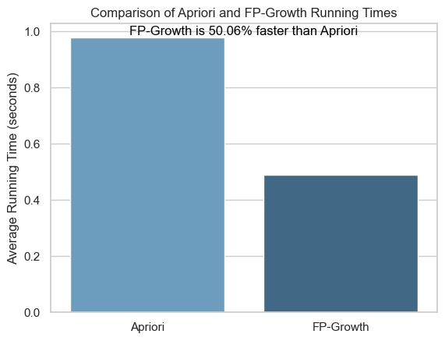
Chosen Market Analysis Model: FP-Growth
FORECASTING ANALYSIS
BUSINESS ANALYTICS
AIRFLOW AUTOMATED SYSTEM
RECOMMENDATIONS
Market Basket Analysis:
Chosen Model
Apriori Or FP-Growth

Slide 40
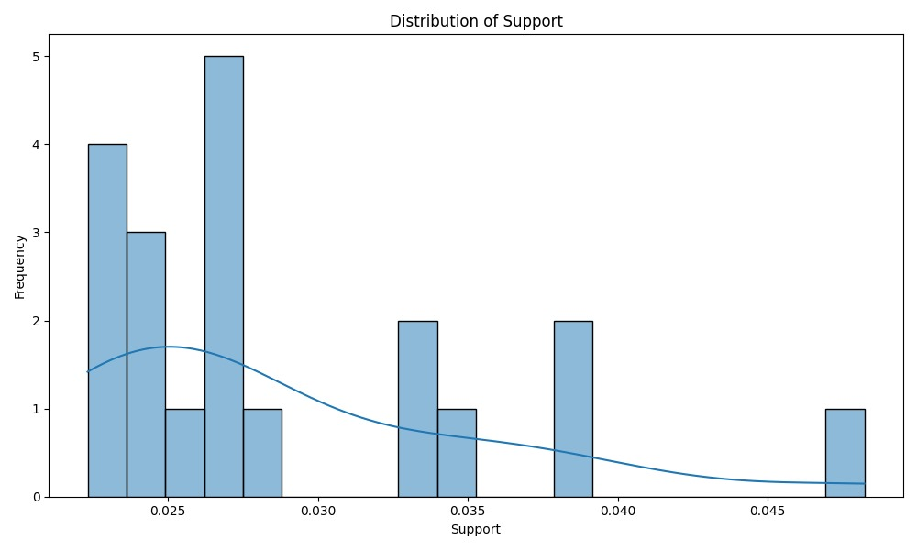
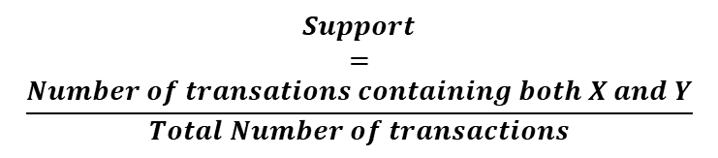
INTRODUCTION
OBJECTIVES
ETL PROCESS
DATA RECONCILIATION
DASHBOARD
$$Support$$
$$=$$
$$\frac{Number of transations containing both X and Y}{Total Number of transactions}$$
Market Basket
Analysis:
Why LOW support?
2550 orders
Median = 12
Mean = 38
STD = 57
Sparse Data
Low Support

Slide 41
WHY Automate?
FORECASTING ANALYSIS
BUSINESS ANALYTICS
AIRFLOW AUTOMATED SYSTEM
RECOMMENDATIONS
01
Reducing Manual Workload and Human Errors
02
Increased Operational Control with Error Handling
Efficient Handling of Large-Scale Data an Errors
03
Adaptability to Business Expansion and Data Volume
04

Slide 42
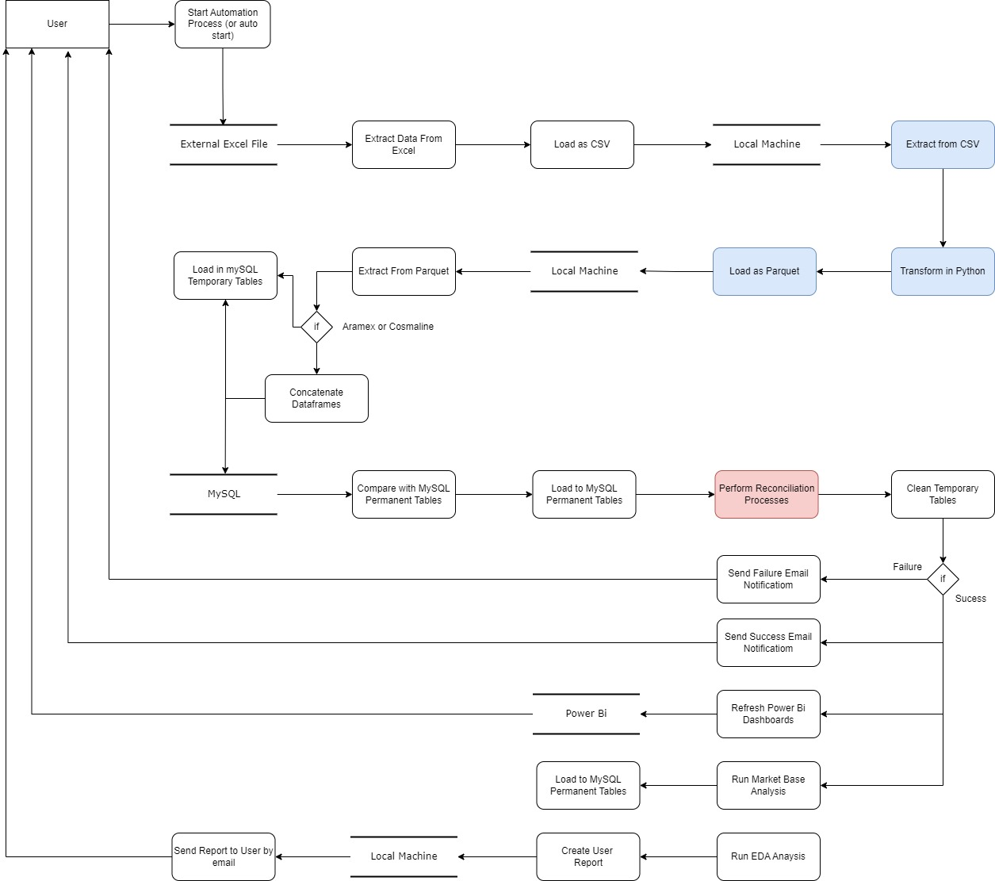
Data Flow Diagram
FORECASTING ANALYSIS
BUSINESS ANALYTICS
AIRFLOW AUTOMATED SYSTEM
RECOMMENDATIONS

Slide 43




WHY Airflow?
FORECASTING ANALYSIS
BUSINESS ANALYTICS
AIRFLOW AUTOMATED SYSTEM
RECOMMENDATIONS

Slide 44
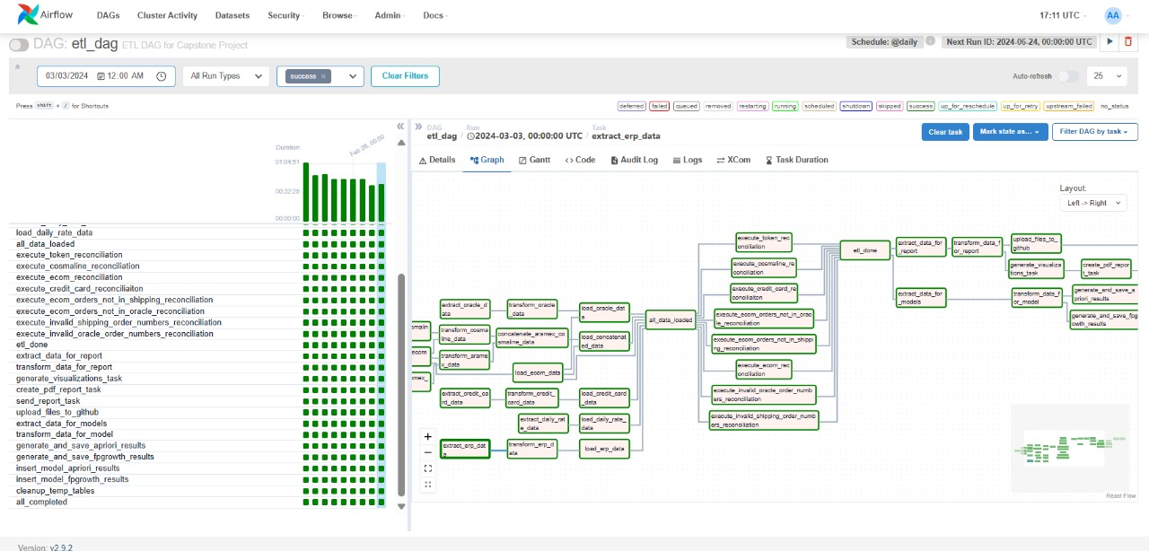
Airflow Web Interface
FORECASTING ANALYSIS
BUSINESS ANALYTICS
AIRFLOW AUTOMATED SYSTEM
RECOMMENDATIONS

Slide 45
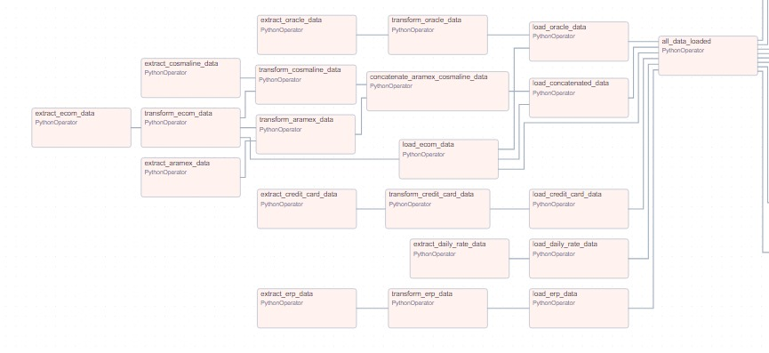
FORECASTING ANALYSIS
BUSINESS ANALYTICS
AIRFLOW AUTOMATED SYSTEM
RECOMMENDATIONS
ETL Process:
In Directed Acyclic Graph

Slide 46
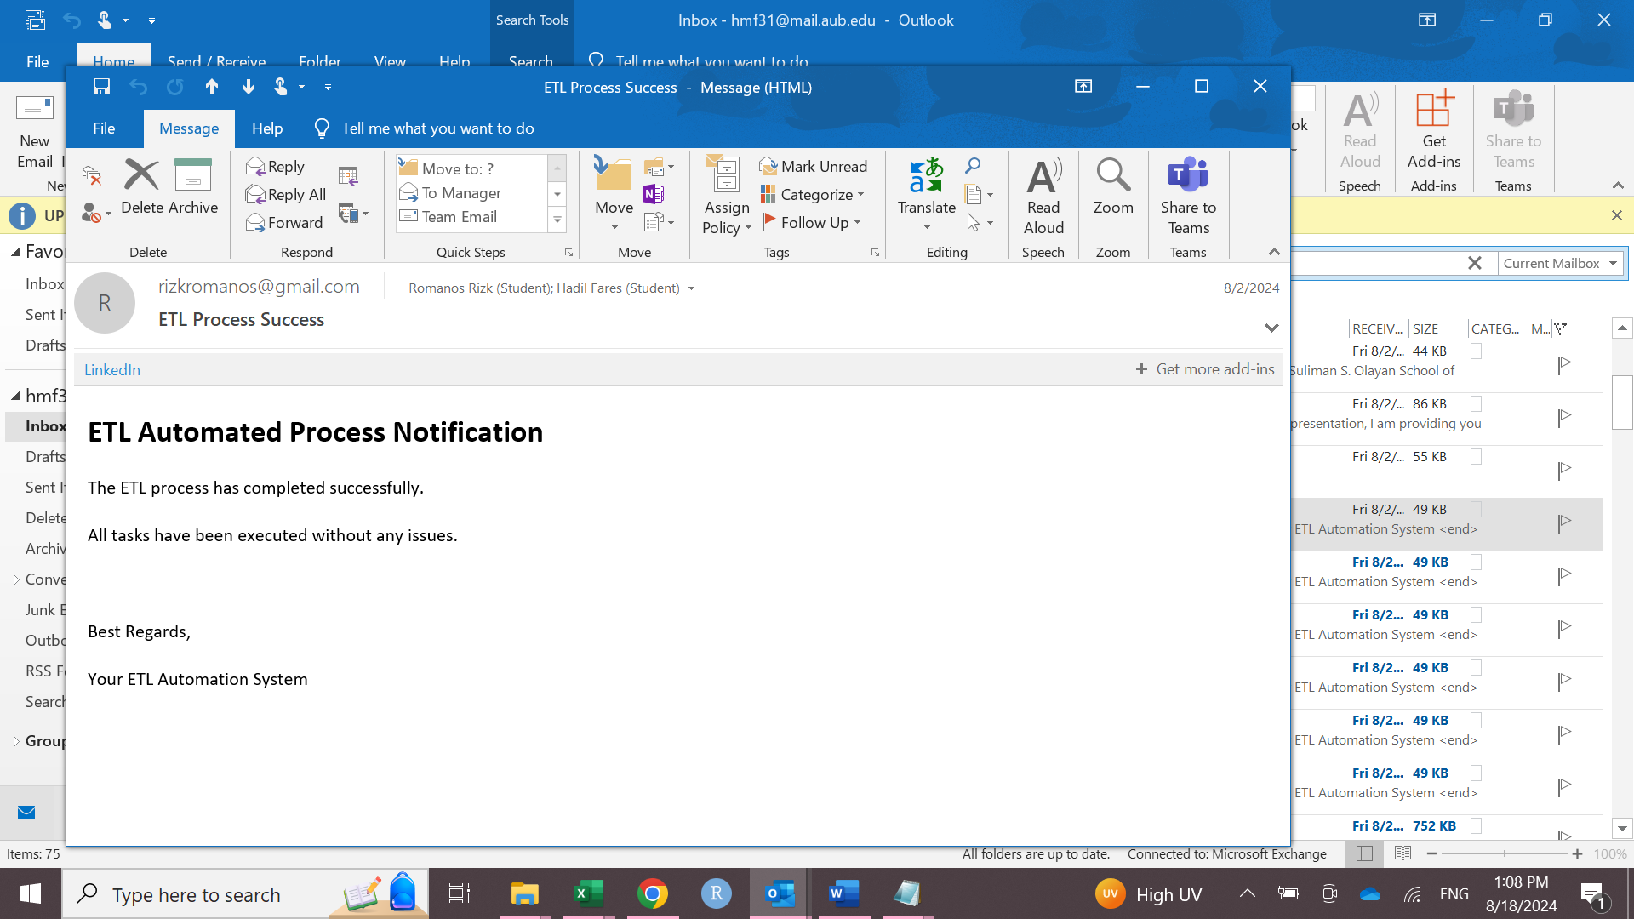
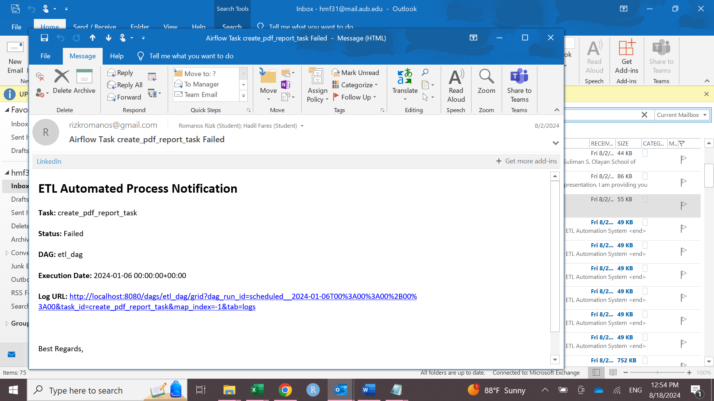
FORECASTING ANALYSIS
BUSINESS ANALYTICS
AIRFLOW AUTOMATED SYSTEM
RECOMMENDATIONS
ETL Process:
Success and Failure Emails

Slide 47
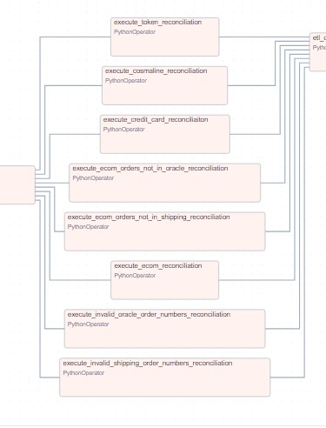
FORECASTING ANALYSIS
BUSINESS ANALYTICS
AIRFLOW AUTOMATED SYSTEM
RECOMMENDATIONS
Data Reconciliation:
In Directed Acyclic Graph

Slide 48

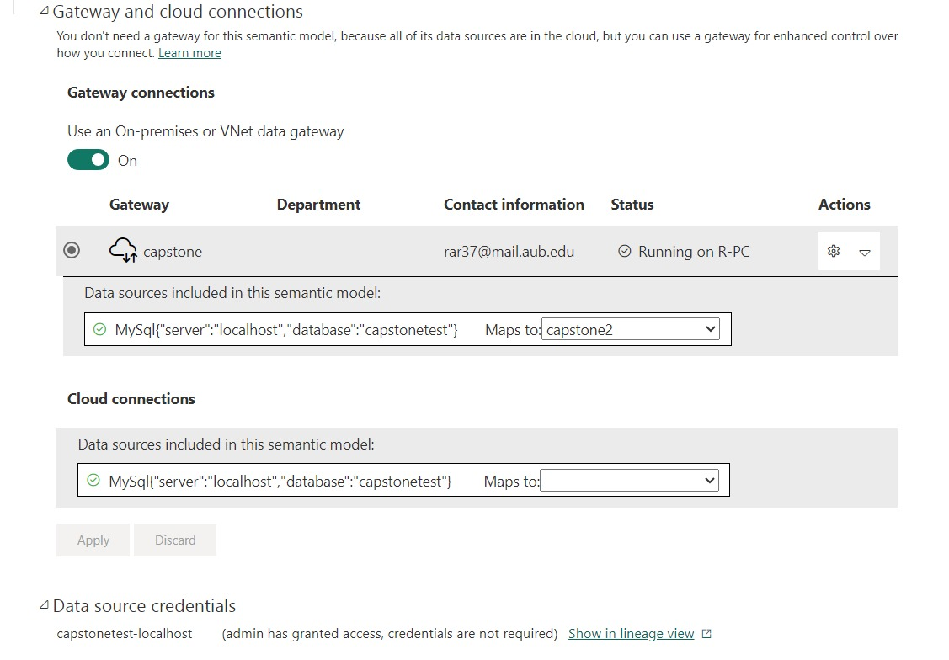
FORECASTING ANALYSIS
BUSINESS ANALYTICS
AIRFLOW AUTOMATED SYSTEM
RECOMMENDATIONS
Gateway:
Between database
& Power BI services

Slide 49
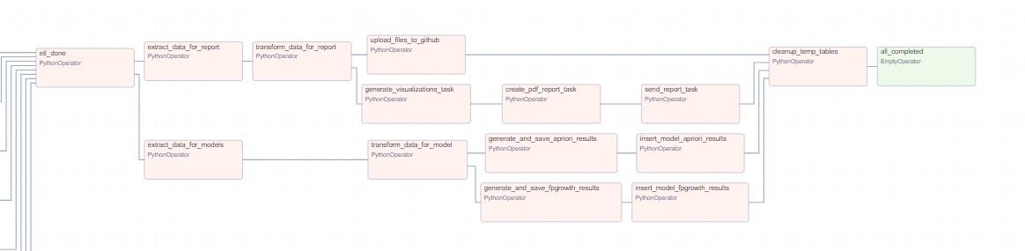
FORECASTING ANALYSIS
BUSINESS ANALYTICS
AIRFLOW AUTOMATED SYSTEM
RECOMMENDATIONS
EDA, MBA,
& Streamlit data refresh:
In Directed Acyclic Graph

Slide 50
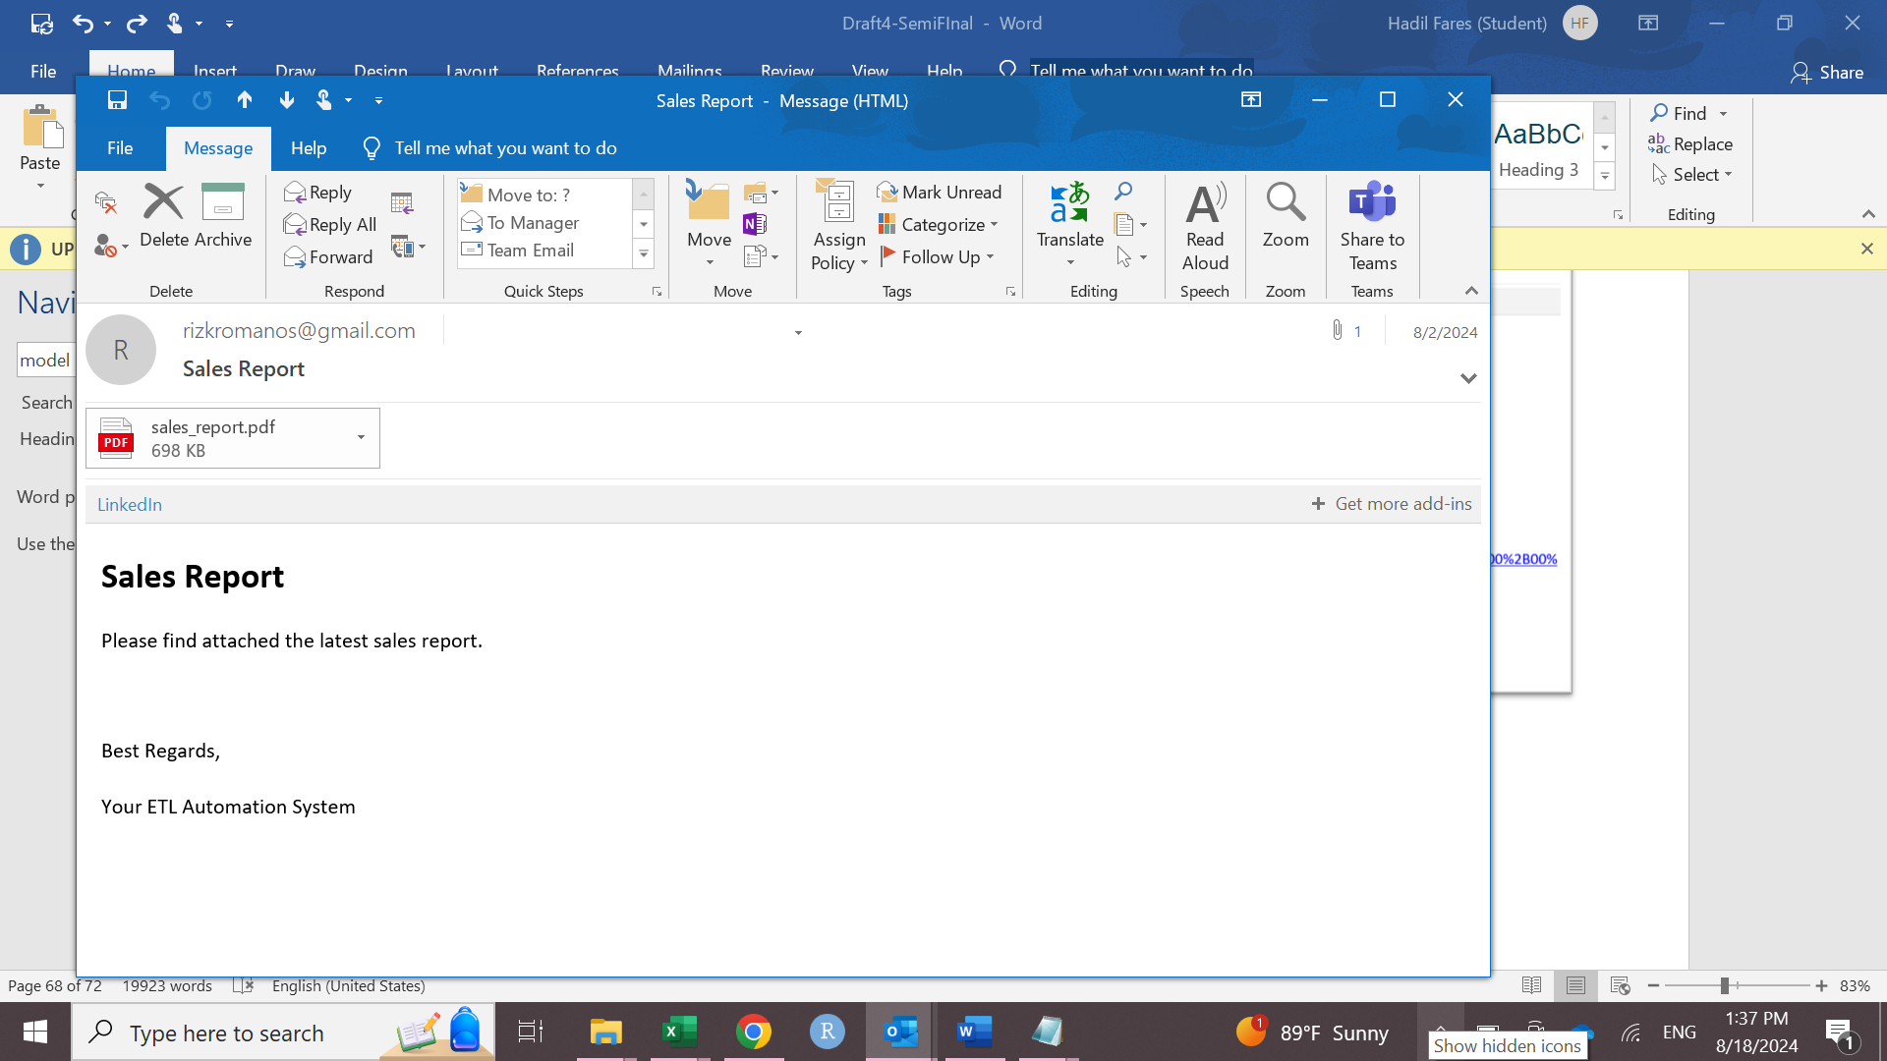
FORECASTING ANALYSIS
BUSINESS ANALYTICS
AIRFLOW AUTOMATED SYSTEM
RECOMMENDATIONS
EDA and MBA:
Sales Report Email

Slide 51
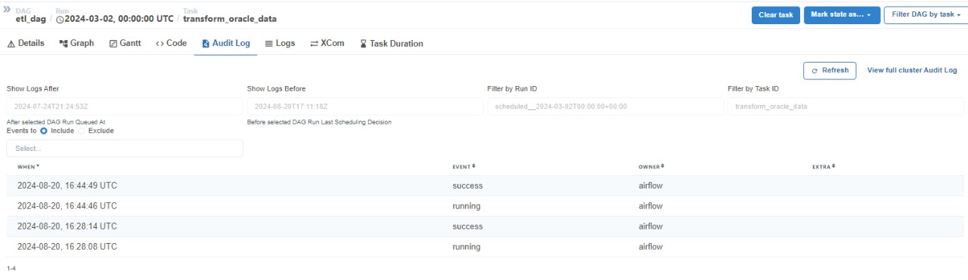
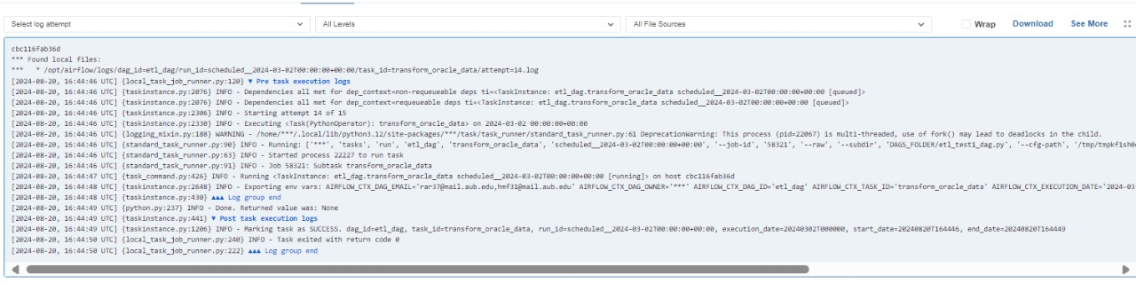
FORECASTING ANALYSIS
BUSINESS ANALYTICS
AIRFLOW AUTOMATED SYSTEM
RECOMMENDATIONS
LOGS

Slide 52

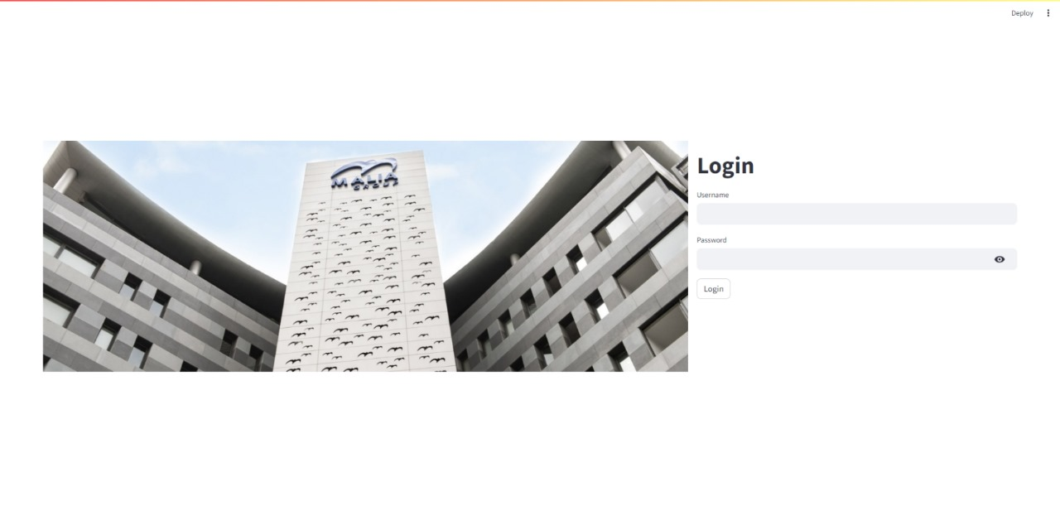
FORECASTING ANALYSIS
BUSINESS ANALYTICS
AIRFLOW AUTOMATED SYSTEM
RECOMMENDATIONS

Slide 53
FORECASTING ANALYSIS
BUSINESS ANALYTICS
AIRFLOW AUTOMATED SYSTEM
RECOMMENDATIONS
Reconciliation: Recommendations
Enhance E-Commerce and Credit Card Transaction Synchronization
Improve E-Commerce and ERP Integration
Rely Fully on Aramex for Shipping
Implement real-time APIs integration between the e-commerce platform and the ERP system to ensure data synchronization.
Establish a robust API integration for synchronizing CyberSource credit card transactions with ERP data.
Expand reliance on Aramex for all product shipping and cash collection activities.
53

Slide 54
FORECASTING ANALYSIS
BUSINESS ANALYTICS
AIRFLOW AUTOMATED SYSTEM
RECOMMENDATIONS
Order size-based promotion & Delivery Fees
5
to
10
Offer customers free items from underperforming categories (e.g., cosmetics) for orders above $20.
Unique items per basket
Order size-based promotion
&
$10
$18
Eliminate delivery fees for customers who purchase from low-performing categories.
to
Delivery Fees
Basket Value

Slide 55
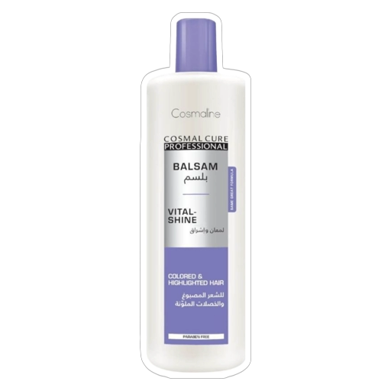
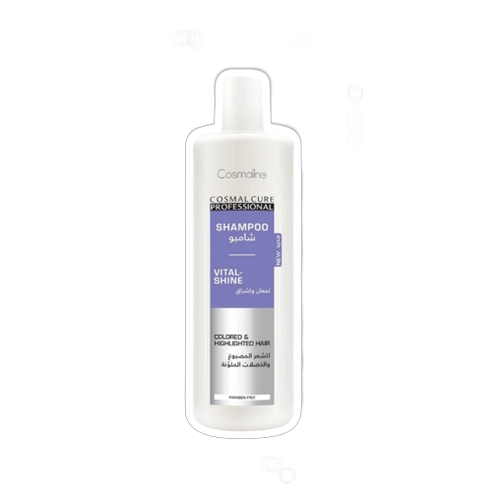
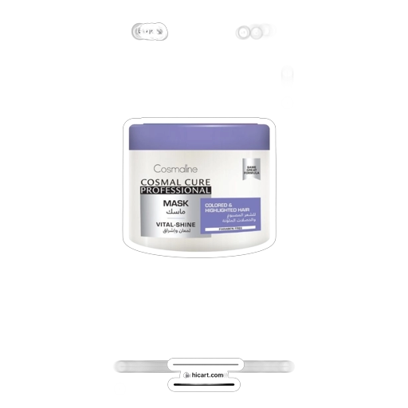
FORECASTING ANALYSIS
BUSINESS ANALYTICS
AIRFLOW AUTOMATED SYSTEM
RECOMMENDATIONS
Bundling
X
X
Colored Hair Care Bundle
$2.30
$2.20
$2.85
Fall Control Bundle
Damaged Hair Care Bundle
Kids Hair Care Bundles
X
$7.35
Hijab Hair Care Bundle
$6.30

Slide 56
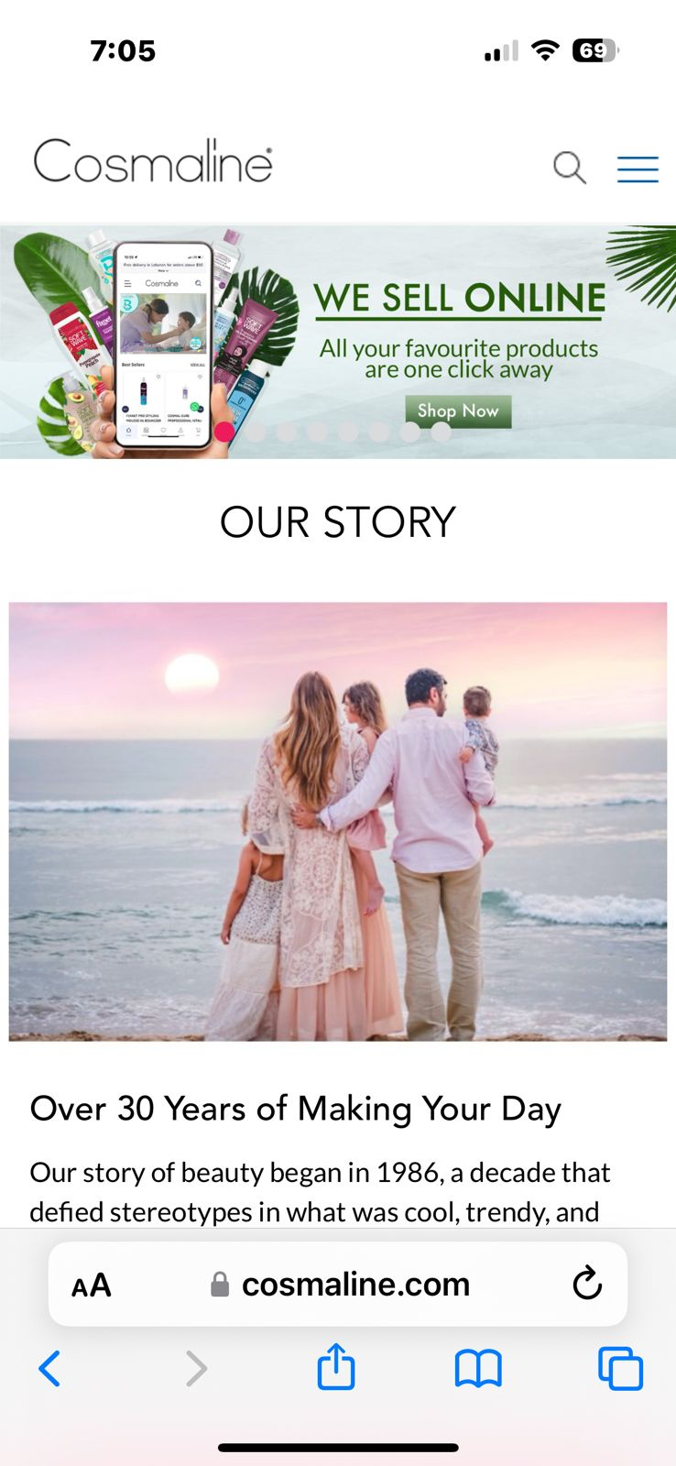
FORECASTING ANALYSIS
BUSINESS ANALYTICS
AIRFLOW AUTOMATED SYSTEM
RECOMMENDATIONS
Cross-Selling
COSMALINE’S
Website

Slide 57
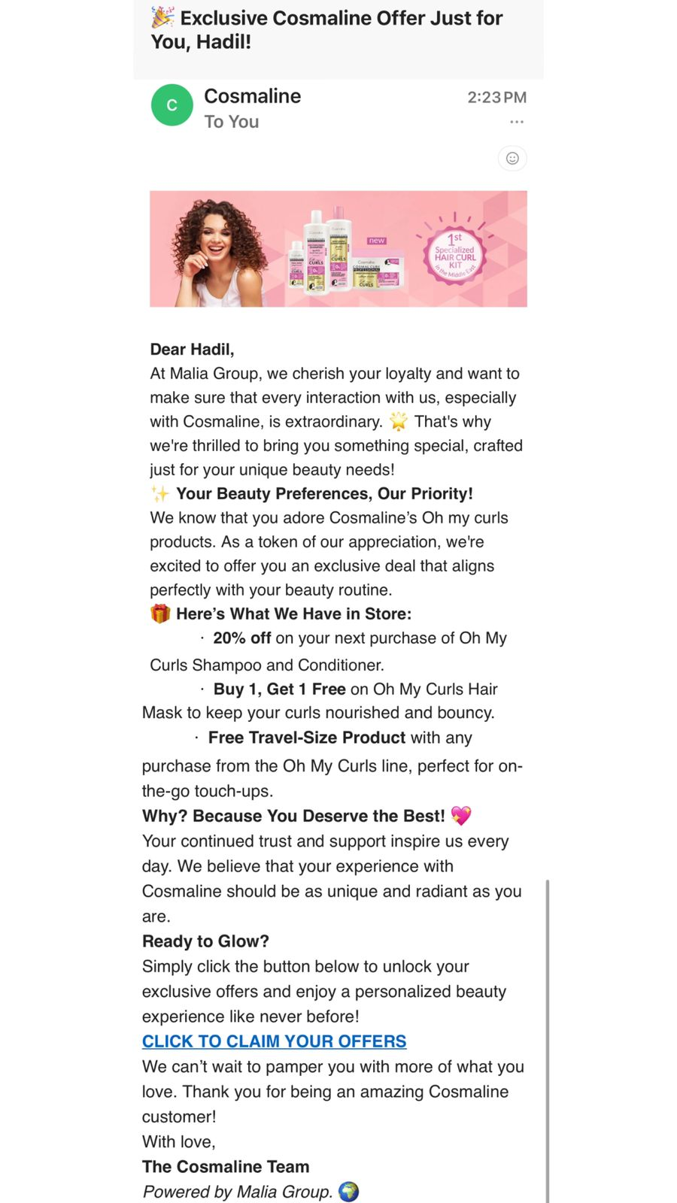
FORECASTING ANALYSIS
BUSINESS ANALYTICS
AIRFLOW AUTOMATED SYSTEM
RECOMMENDATIONS
What Could Have Been Done?
with Customer Data

Slide 58
Automated Airflow System
ETL
Data
Reconciliation
Real time monitoring
Market Basket Analysis
Streamlit Application
EDA
Error Handling procedures
Email
Notification System

Slide 59
X
THANK YOU
Romanos Rizk – 202471561
Hadil Fares - 202472597

